Slide 1




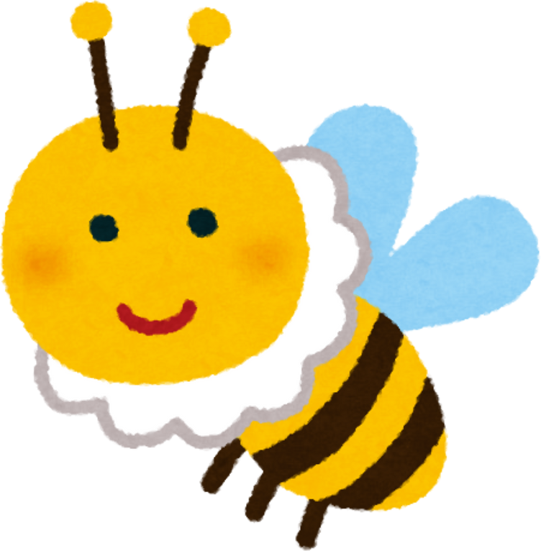

SPARK YOUR INNER GLIMMER
PROJECT
EDUCATOR: RACHEL BURNELL

Slide 2
GROUP AGREEMENT
  Respect and kindness
  Opt out available
  Safe space
  Confidentiality
  No such thing as a silly question
t

Slide 3
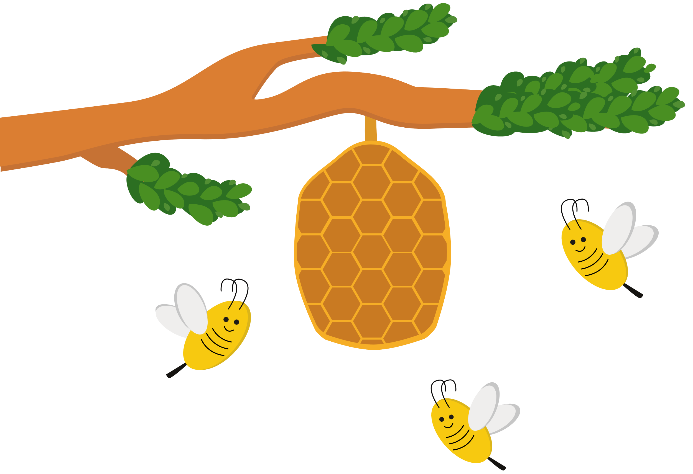
Background
This project has been created to support neurodivergent girls and young women to increase confidence, develop assertiveness and to be able to advocate for their needs in all kinds of relationships.
Girls in the UK are diagnosed up to 6 years later than boys and 80% remain undiagnosed at age 18 due to (often unconsciously) masking their autistic traits in order to fit in with their peers. This camouflaging can lead to negative effects on mental health, confidence and self-esteem. Autistic girls are more vulnerable to abuse and exploitation in relationships, so learning to build self esteem and become assertive early on is a protective factor that can be taught.
It is estimated that around 50-70% of autistic people also have ADHD, so this project is also designed to suit those with ADHD and co-occuring forms of neurodivergence.

Slide 4

Session 1: It All Starts With Self-esteem!
What is self esteem?
What can affect our self esteem?
How can we build and protect it?
Activities:
Kind to My Mind mini book
Mirror, Mirror
Negative or Positive Self Talk?
Inner/outer self craft

Slide 5

Session 2: Emotions in Motion
Activities:
Discussion cards
Feelings wheel and emotion logs
Connecting body and mind (identifying sensations in the body)
Applying coping strategies
Identifying a range of emotions
Feelings as a form of communication
Coping with strong emotions
Alexythymia
Managing shutdowns/meltdowns

Slide 6
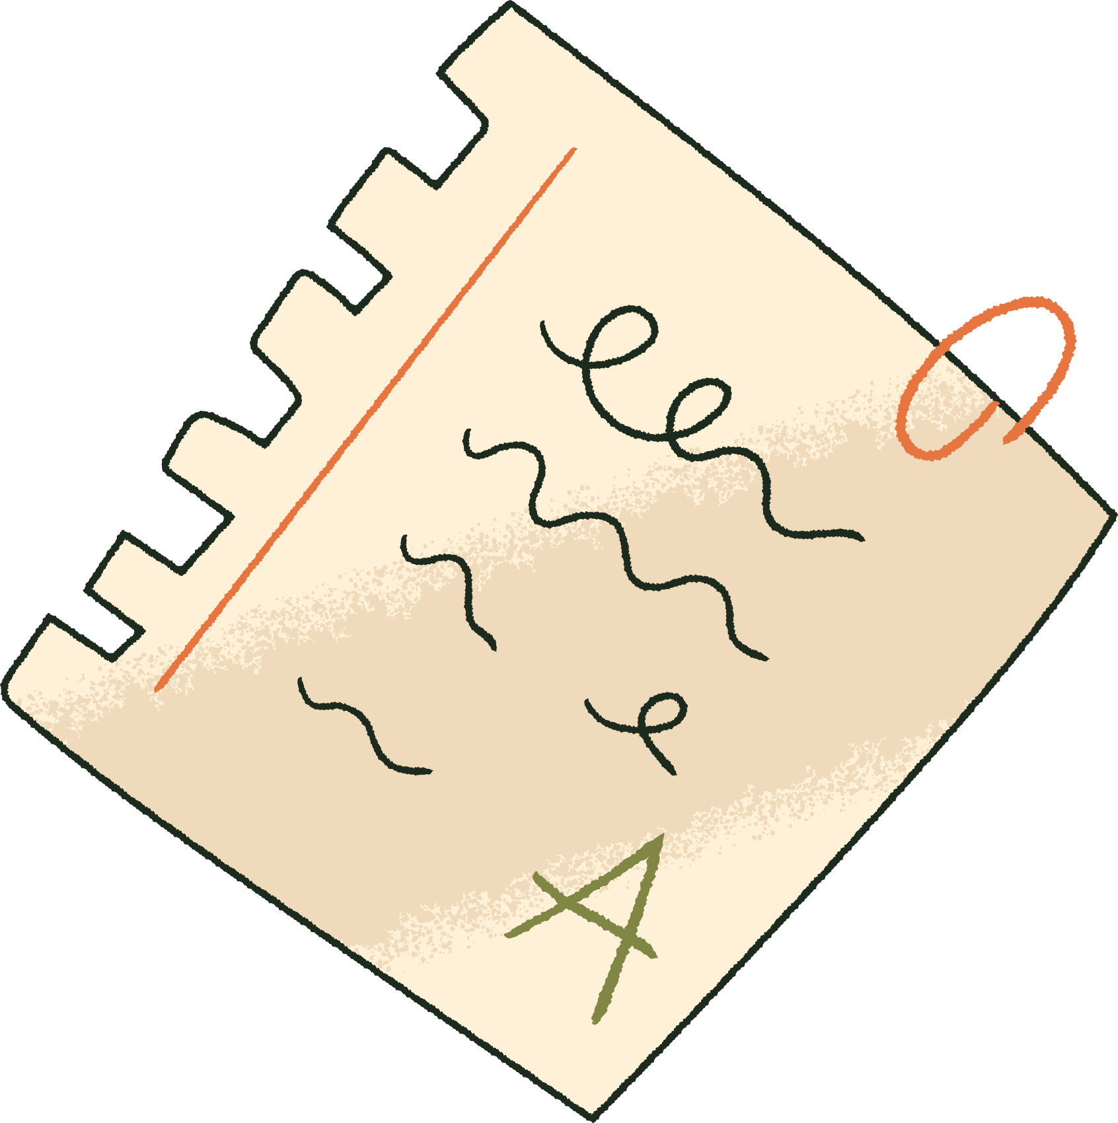
Session 3: How to Bee Assertive!
What do we mean by assertiveness?
How to assert yourself confidently
Speaking up and saying no
1
Activities:
Role play scenarios and case studies
Assertiveness cue cards
Buzz Off! board game
2

Slide 7
Session 4: Bee-ing a Great Friend
What are the qualities of a healthy friendship?
How to deal with friendship issues/conflict
Neurodivergent love languages
Inclusive and kind friendships
1
Activities:
Inclusive Friendships
Bestie or bully?
Role play scenarios and conflict resolution cards
Penguin Pebbles game and love language craft
2

Slide 8
Session 5: Consent and Body Boundaries
Circles of Intimacy
Which types of contact are safe?
What is meant by consent?
Healthy relationships checklist
1
Activities:
How Close? : Circle of Friends activity
Crossing the Line cards
Parts That Are Private
Sort the Consent situations activity
2

Slide 9
Session 6: Celebrating Sensory Joy!
Supporting sensory sensitivities
Identifying glimmers and glows
The importance of monotropic interests
Activities:
Sensory Sensitivities Wheel
Energy and Emotions Cards
Glimmer art and self care kits
.

Slide 10
Session 7: Be Who You Are Made to Be!
The final session will culminate in a creative collage activity to celebrate the pupils’ individual strengths and abilities.
They will be able to choose the artistic media they would like to use to represent themselves and at the end of the session will share their creations with the group.

Slide 11
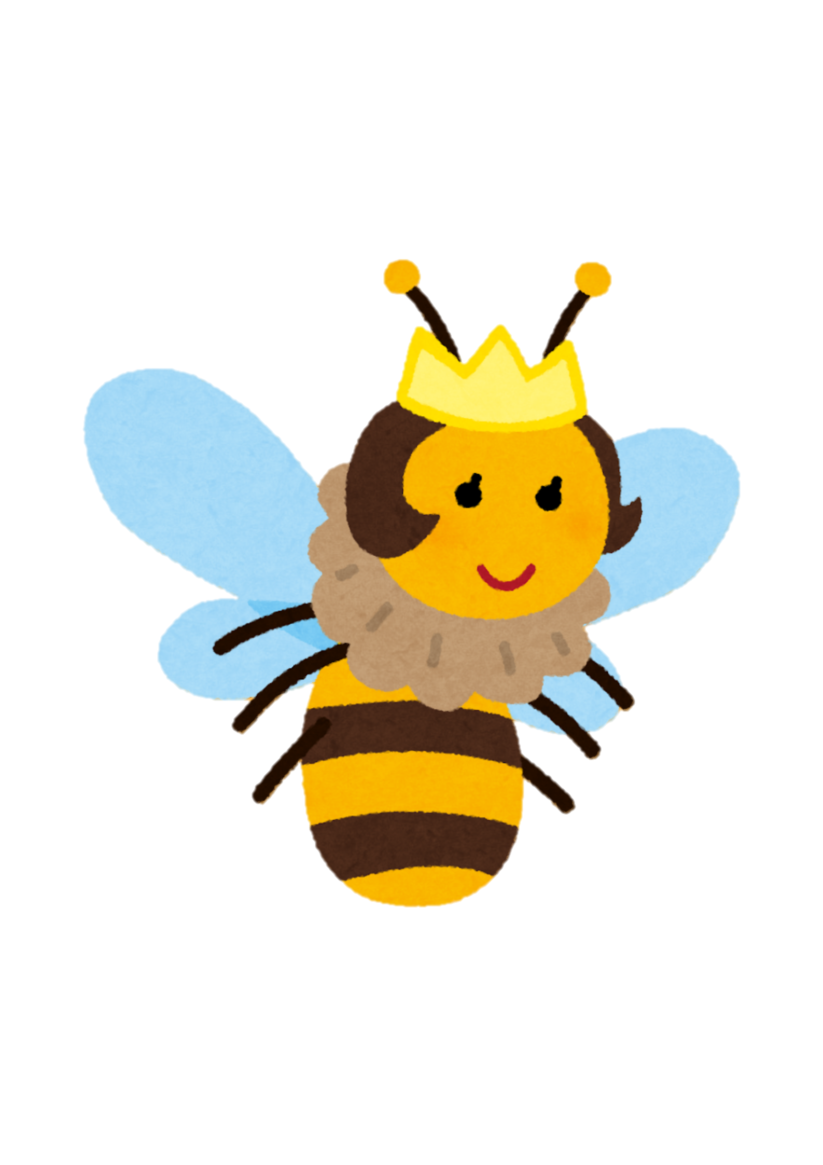
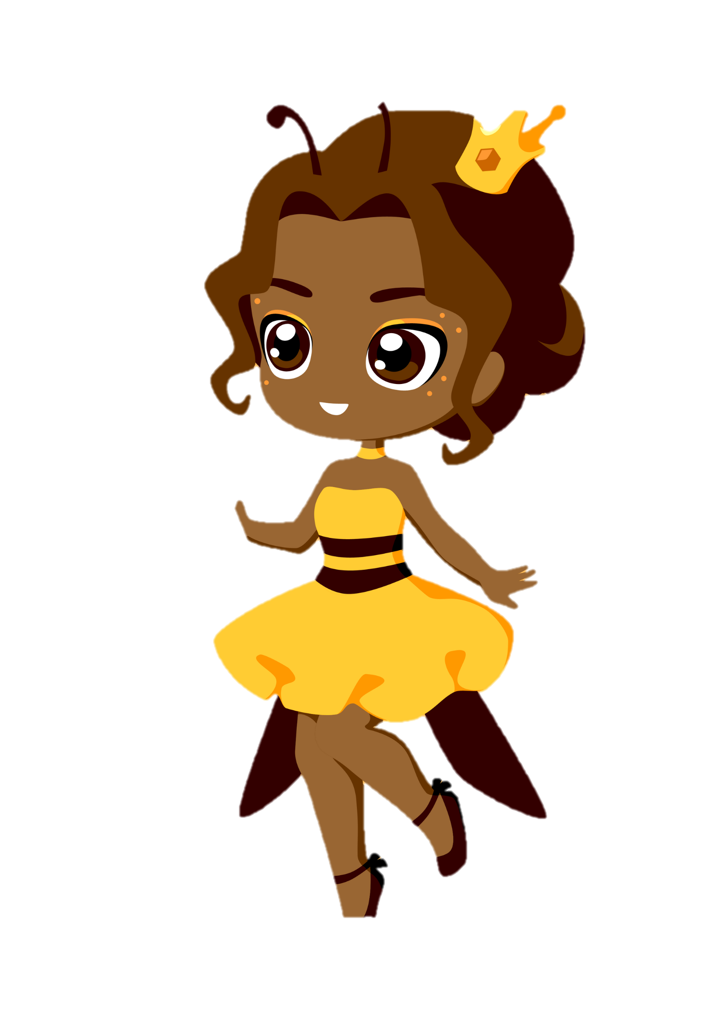
Session 7: Be Who You Are Made to Be!
The final session will culminate in a creative collage activity to celebrate the pupils’ individual strengths and abilities.
They will be able to choose the artistic media they would like to use to represent themselves and at the end of the session will share their creations with the group.

Slide 12

THANK
YOU
You are the Bees Knees!
(well not literally but metaphorically)

